Slide 1
OOP Address Book
Class project

Slide 2
Presented By
Md Roknuzzaman
ID: 151-35-906

Slide 3
INTRODUCTION
In this project we are going to build a software model for a SIMPLE ADDRESS BOOK.
By this Address Book application we are going to store the detail’s of people
It mainly contains the following details
Create a person, Add a person, Edit a person, Delete a person etc

Slide 4
BACKGROUND WORK
The software to be designed as a program that can be used to maintain an address book
An address book holds a collection of entries and each recordings a person’s first name, last name, address, state, zip and phone number.
The most important entry to add a new person are first name and zip

Slide 5
PURPOSE
The main purpose of building this project is to make a user friendly address book system. . In real life there are certain times where we loose our contacts from mobile or system in that time this application will be helpful. An online address book typically enables users to create their own web page (or profile page) which is then indexed by search engines like Google and Yahoo.

Slide 6
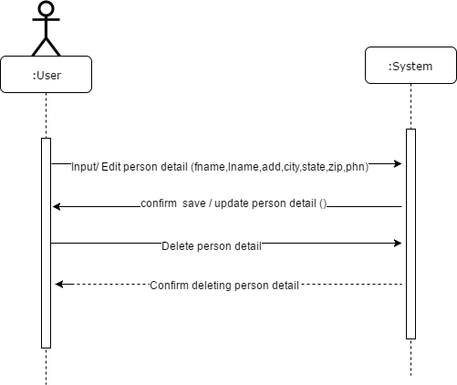
SYSTEM SEQUENCE DIAGRAM

Slide 7
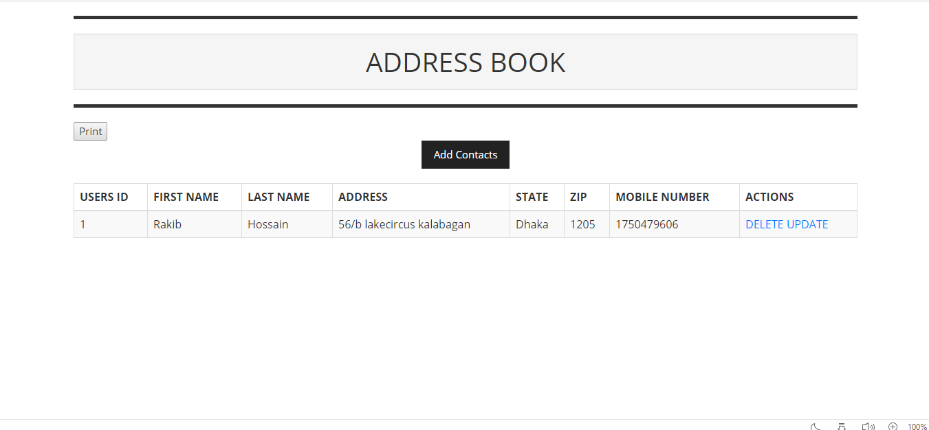
HOME PAGE

Slide 8

VIDEO OF PROJECT

